Slide 1
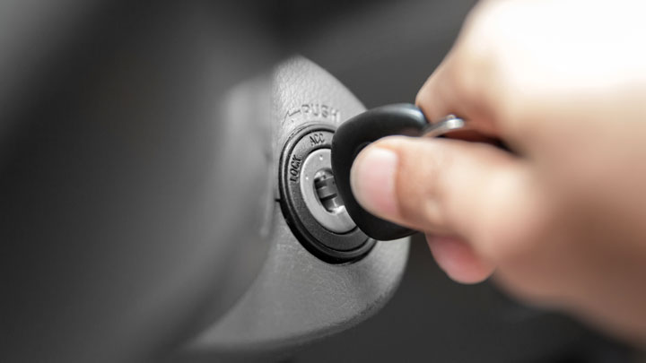
IMMOBILIZER & LIGHTING
Team Names :-
1) VINAYAK DESAI
2) SARFAROZ NAWAZ
3) AJAY KALSHETTY
4) ASAMPALLY JAGaDISH

Slide 2
PROJECT-REQUIREMENTS
Requirement_ID | Type | Object text | Status | Task _ID | Review_ID | Remarks
IL_ID1 | Heading | Access request with key (CAN message Input) | Praposed | IL_NVJA
IL_ID2 | Definition | To accessing the key from user. | Praposed | IL_NVJA
IL_ID3 | Comment | CANCON and CANSTAT Registers to setting CAN bus to Normal mode.,Key_ID,Data registers,Timer,Led | Praposed | IL_NVJA
IL_ID4 | Requirement | Consider access request key as a Can message ID. | Praposed | IL_NVJA
IL_ID5 |  | then ECU will receive key ID(CAN message), after that it will compare with initial key ID or received key ID. | Praposed | IL_NVJA
IL_ID6 |  | then it will check it is Authorised key or not if it not matches lamp will blink for 1 second then. | Praposed | IL_NVJA
IL_ID7 |  | if key matches lamp will blink for 3 seconds. | Praposed | IL_NVJA
IL_ID8 |  | also as output indication if key matches the buzzer will beep for 3 times. | Praposed | IL_NVJA
IL_ID5 | Heading | Identify Unauthorised key | Praposed | IL_NVJA
IL_ID6 | Definition | Checking authorised key or not. | Praposed | IL_NVJA
IL_ID7 | Comment | CANCON Registers,Key_ID,Data registers,Timer,buzzer | Praposed | IL_NVJA
IL_ID8 | Requirement | If unauthorised key trying to access then it will warns | Praposed | IL_NVJA
IL_ID9 |  | If unauthorised key trying to access 1st attempt buzzer will beep for 3 times. | Praposed | IL_NVJA
IL_ID10 |  | If unauthorised key trying to access 2nd time it will beep for 6 times | Praposed | IL_NVJA
IL_ID11 |  | If unauthorised key trying to access 3rd attempt it will beep continuous | Praposed | IL_NVJA
IL_ID9 | Heading | Door Status (Hardware Input) | Praposed | IL_NVJA
IL_ID10 | Definition | It will check the door locked and unlocked process on that bases lamp will ON and OFF | Praposed | IL_NVJA
IL_ID11 | Comment | Switch1,Switch2,Lamp,Buzzer,Timer. | Praposed | IL_NVJA
IL_ID12 | Requirement | At the same time it will check door status (hardware input). | Praposed | IL_NVJA
IL_ID13 |  | if input key ID matches then it will check door locked or not if not matches door status will fail and it will not work. | Praposed | IL_NVJA
IL_ID14 |  | if key matches after that also it will check door status If door is Unlocked then buzzer will give single beep and warning lamp will ON for 3 seconds then it will off. | Praposed | IL_NVJA
IL_ID15 |  | In the same way if door is locked then warning lamps will ON and OFF for 1 sec for 3 times. | Praposed | IL_NVJA
IL_ID13 | Heading | Storing Data | Praposed | IL_NVJA
IL_ID14 | Definition | Storing the data in memory. | Praposed | IL_NVJA
IL_ID15 | Comment | We have using external memory for storing data.,(EEPROM) | Praposed | IL_NVJA
IL_ID16 | Requirement | Storing the transmitte data and receive data in memory. | Praposed | IL_NVJA
IL_ID17 |  | store key satus data |  | IL_NVJA
IL_ID18 |  | door status data. |  | IL_NVJA

Slide 3
Ignition Key Input
SYSTEM BLOCK DIAGRAM
CAN_Input
IGNITION ECU
RAM
Lamp and Buzzer for warning and indications
Key_ID
Buzzer
Key_ID
CANH
DASHBOARD ECU
EEPROM
CANL
Out_Put
It will send the status of Door locked or Unlock to Dashboard ECU
Key_ID
LAMP
CANH
DOOR status ECU
DOOR_Status
CANL
Hardware_Input

Slide 4
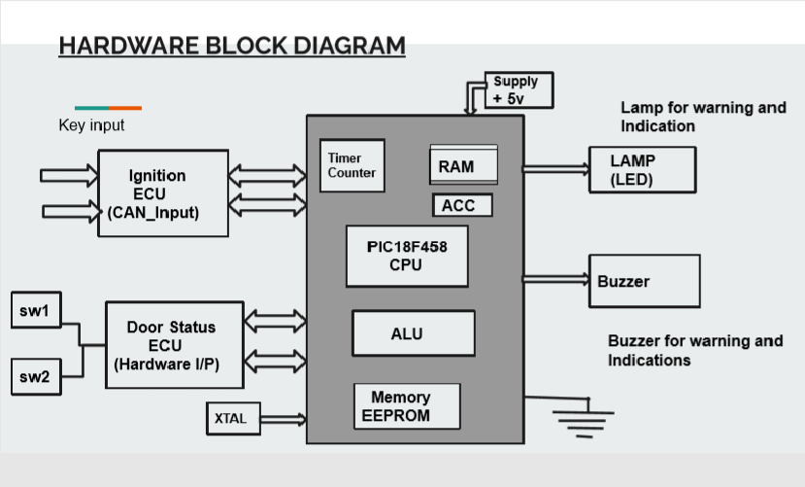

Slide 5
FUNCTIONAL BLOCK DIAGRAM
can_read/can_write
Key_status
CAN Transceiver
sys_init();
can_init();
Checking initial key ID with received key ID
set_baudrate();
set_mask():
set_filter():
delay();
can_read():
can_write():
valid key
Invalid attempt
Unlock
Door_status
1. Buzzer will Beep 1 time
2.Warning lamp ON for 3 sec then OFF
Checking Door locked or unlock
1. Buzzer will Beep 2 times
2.Warning lamp ON/OFF for 1 sec 3 times
1st attempt : 1 beep 3 times
2nd attempt : 1 beep 6 times
3rd attempt : continuous beep
Locked

Slide 6
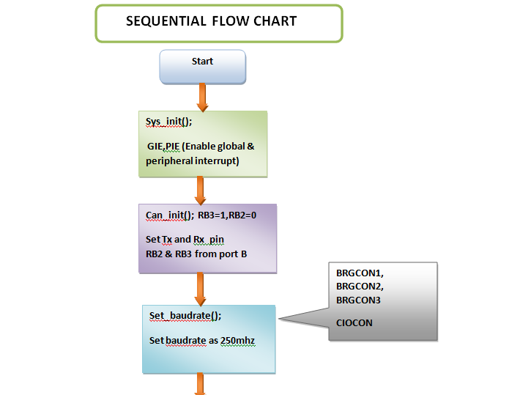

Slide 7
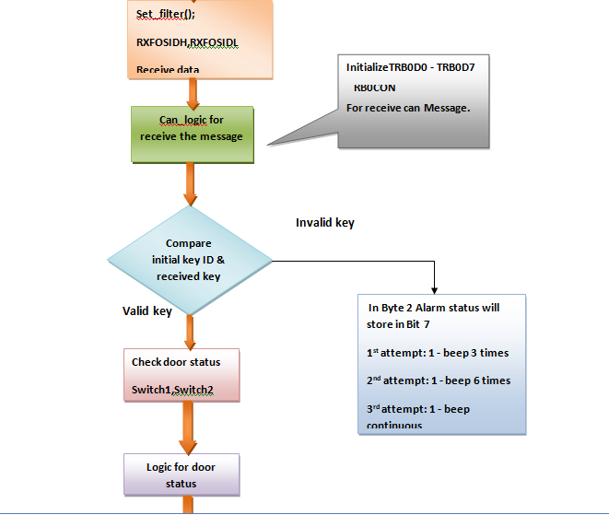

Slide 8
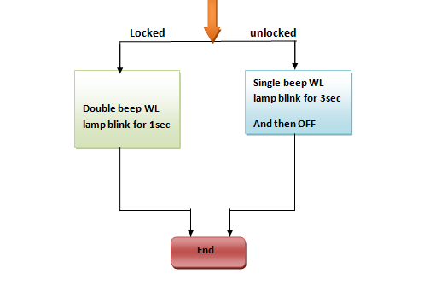

Slide 9
TEST CASES
Test Case ID | Precondition | Test Case Steps | Expected | Obtained | Verdict
IL_ID1 | 1.Connecting ECU to CAN BUS 2.Connected power supply | Checking CAN BUS connected or not | CAN Bus must be Connected
IL_ID2 |  | Checking message is receiving or not from can bus | Message is Receiving from CAN Bus
IL_ID3 |  | Message is Receiving | LED should be OFF
IL_ID4 |  | Message is not receiving | LED should be ON
IL_ID5 |  | Storing data(Write)in EEPROM | We Must read the data which return in EEPROM
IL_ID6 | 1.Connected power supply 2.Connections of LED,Buzzer and Switches | Checking voltages of two switches Switch1 and Switch2 | Checking in multimeter, if switch is off voltage should be low
IL_ID7 |  | working or not | In the same way if Switch is ON voltage should be high
IL_ID8 |  | Checking LED working or not | If it is working LED should be ON,if it is not working LED should be OFF
IL_ID9 |  | Checking Buzzer is working or not | If Buzzer is Working it should make Beep sound,or if it is not working there will be no Beep Sound
IL_ID10 | 1.Checking Key and Door Status | Checking it is Authorised Key or Not | If it is unauthorised key buzzer will beep for 3,6 and final continuos times,if key is authorised it will check the door status
IL_ID11 |  | Checking Door is UnLocked | If door is unlocked single beep and lamp will ON for 3 sec.
IL_ID12 |  | Checking Door is Locked | If door is locked double beep and lamp will ON/OFF for 1 sec 3times

Slide 10
THANK YOU…..!

